Slide 1

Intro to Quantum
By Spencer Churchill — IBM Qiskit Advocate

Slide 2
Overview
Why Quantum?
What is Quantum?
Working with Quantum
Working in Quantum 😉

Slide 3
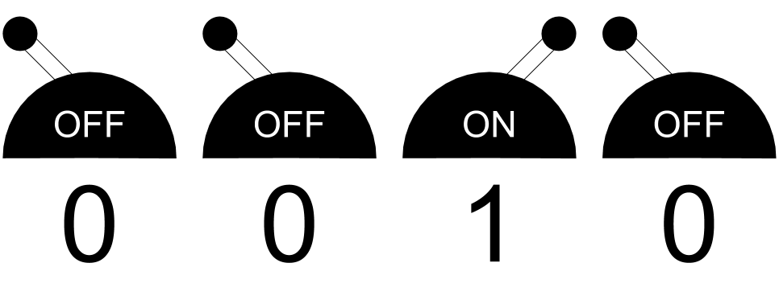
Bits
Why
Bits are transistors which either allow or inhibit electron flow.
Small densely-packed transistors are why your phone is more powerful than 184,000 NASA computers in 1969.
Notes:
Smaller transistors → more transistors → more power

Slide 4
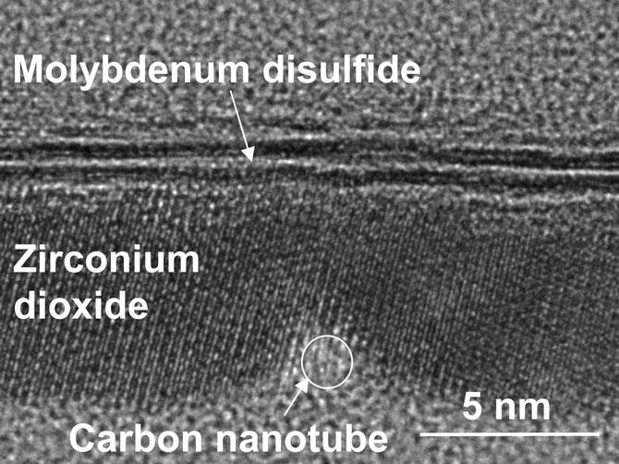
Smaller Transistors Lead to Quantum
Why
As transistors approach the size of atoms (only 30x larger), electrons occasionally “jump” across the gates and do all sorts of funky things.
Soon, we will be limited by size and error.
Notes:
When opening Chrome, very specific transistors need to turn on and off. If electrons continue to flow, unintended actions will occur.
One’s errors are another’s treasures.

Slide 5
How can we go smaller?
What

Slide 6
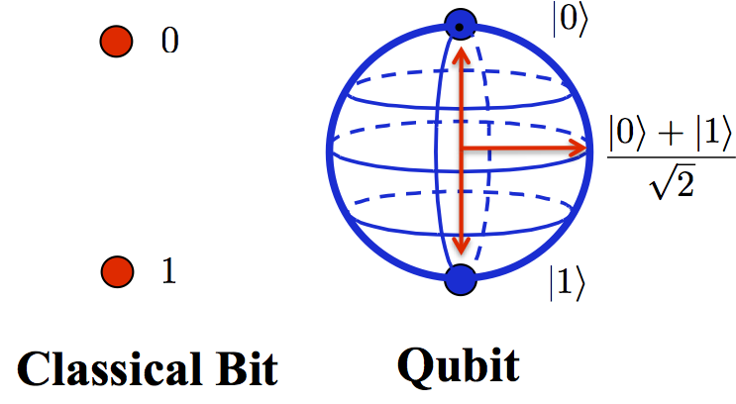
Qubits
What
If we change our idea about a bit
to include quantum properties we can leverage atomic transistors.

Slide 7


What
Superposition
=
+
Entanglement
=
+
Funky things in quantum
Notes:
Note: also interference but we can ignore that for now

Slide 8
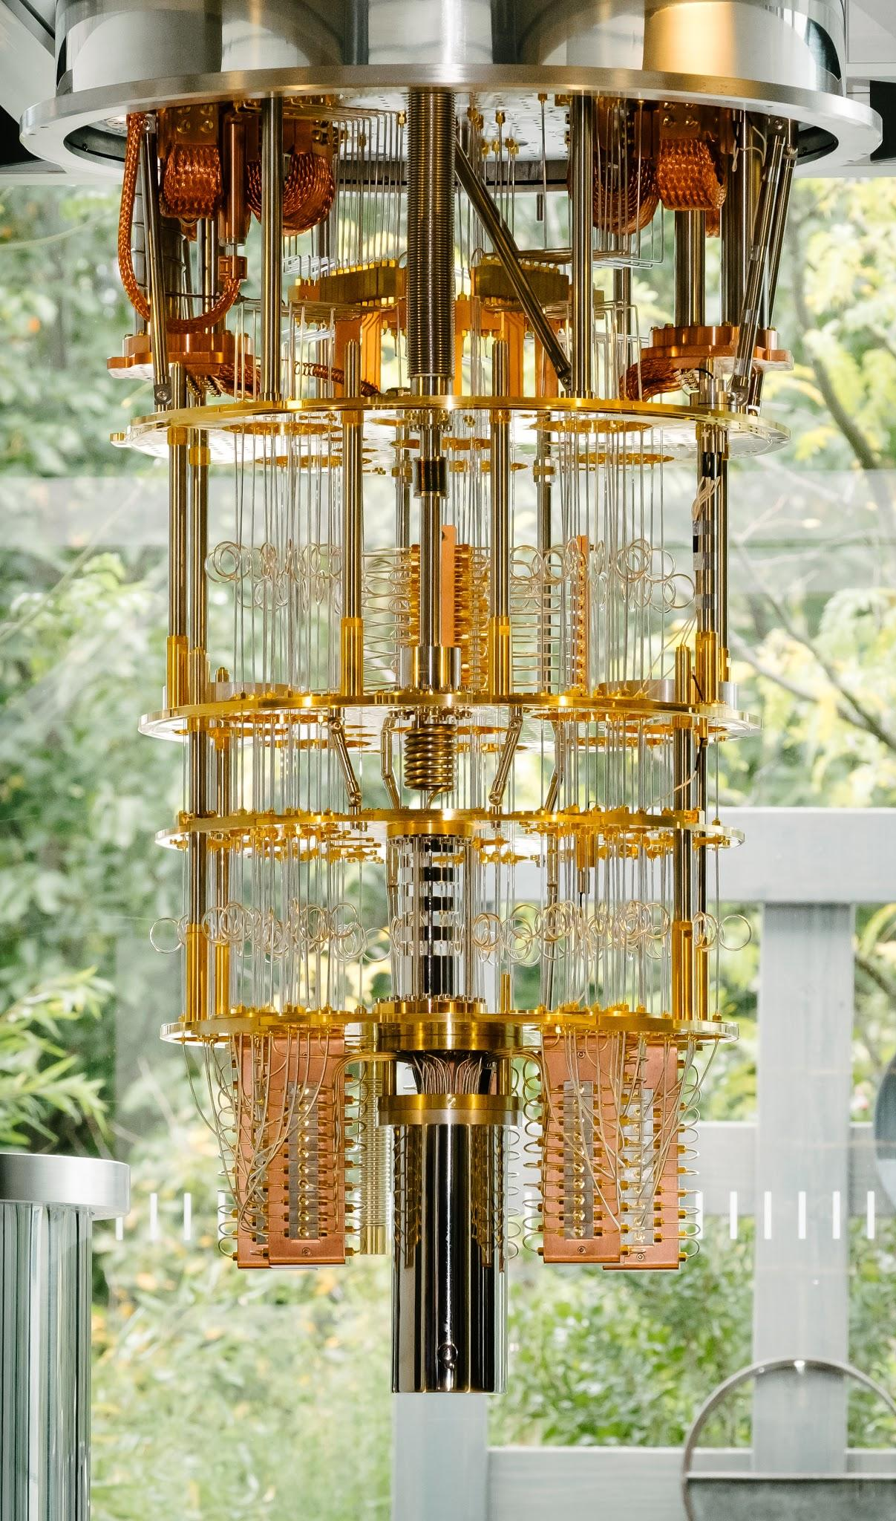
What
Isolated from the environment in a vacuum
Kept at near 0°K
Two conditions must be met to induce quantum effects:
The move from transistors to quantized harmonic oscillators

Slide 9
Simulate Quantum Computing
Working with

Slide 10
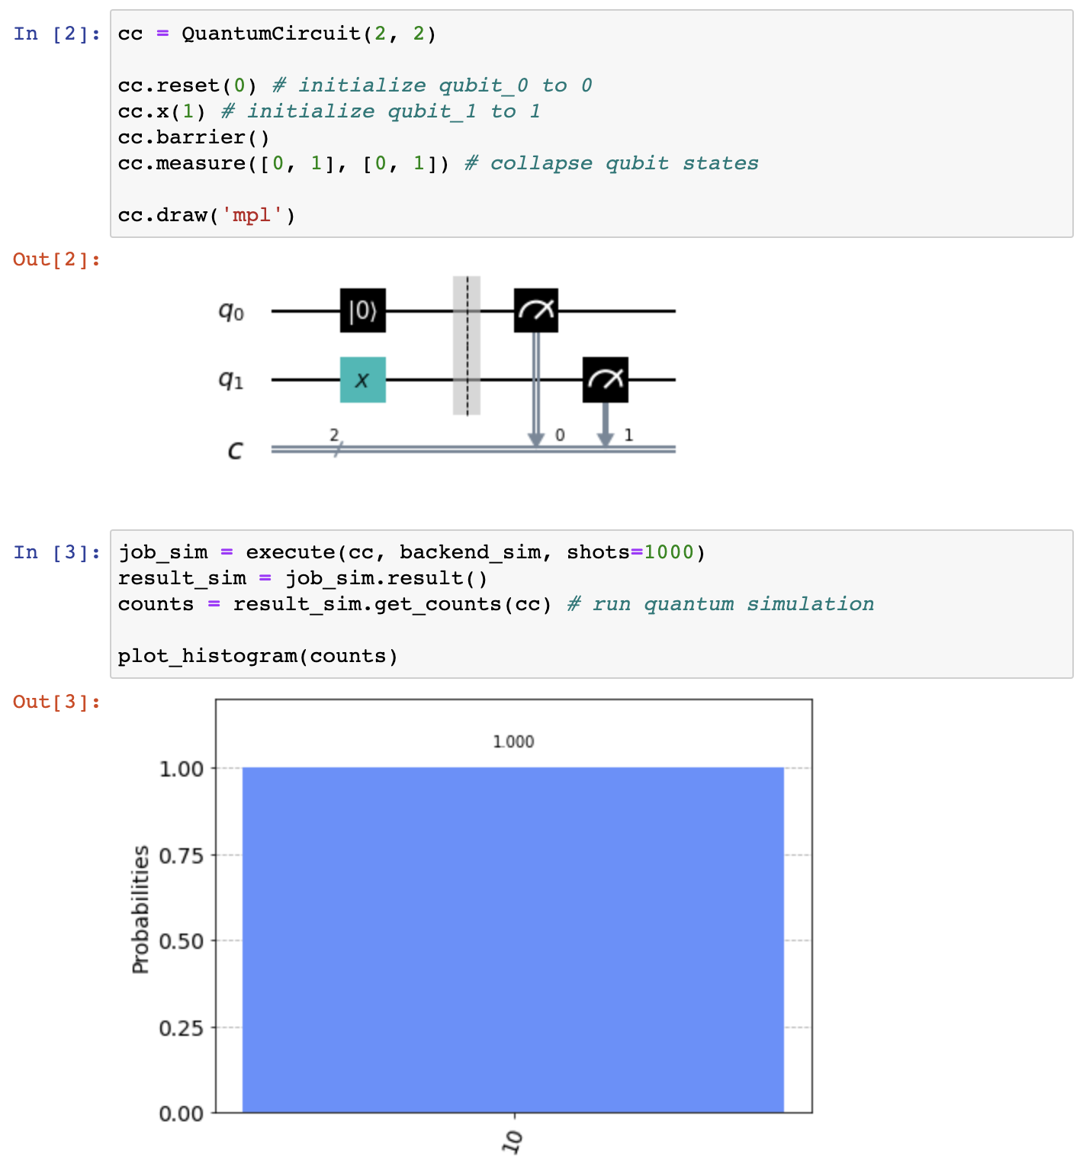
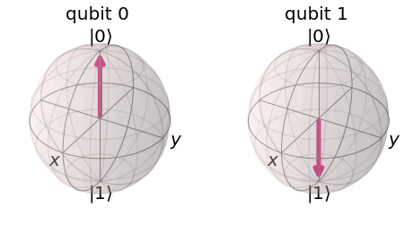
Qubits as bits
Working with
Qubits can behave the same as bits; however, they can exhibit more unique behaviors.

Slide 11
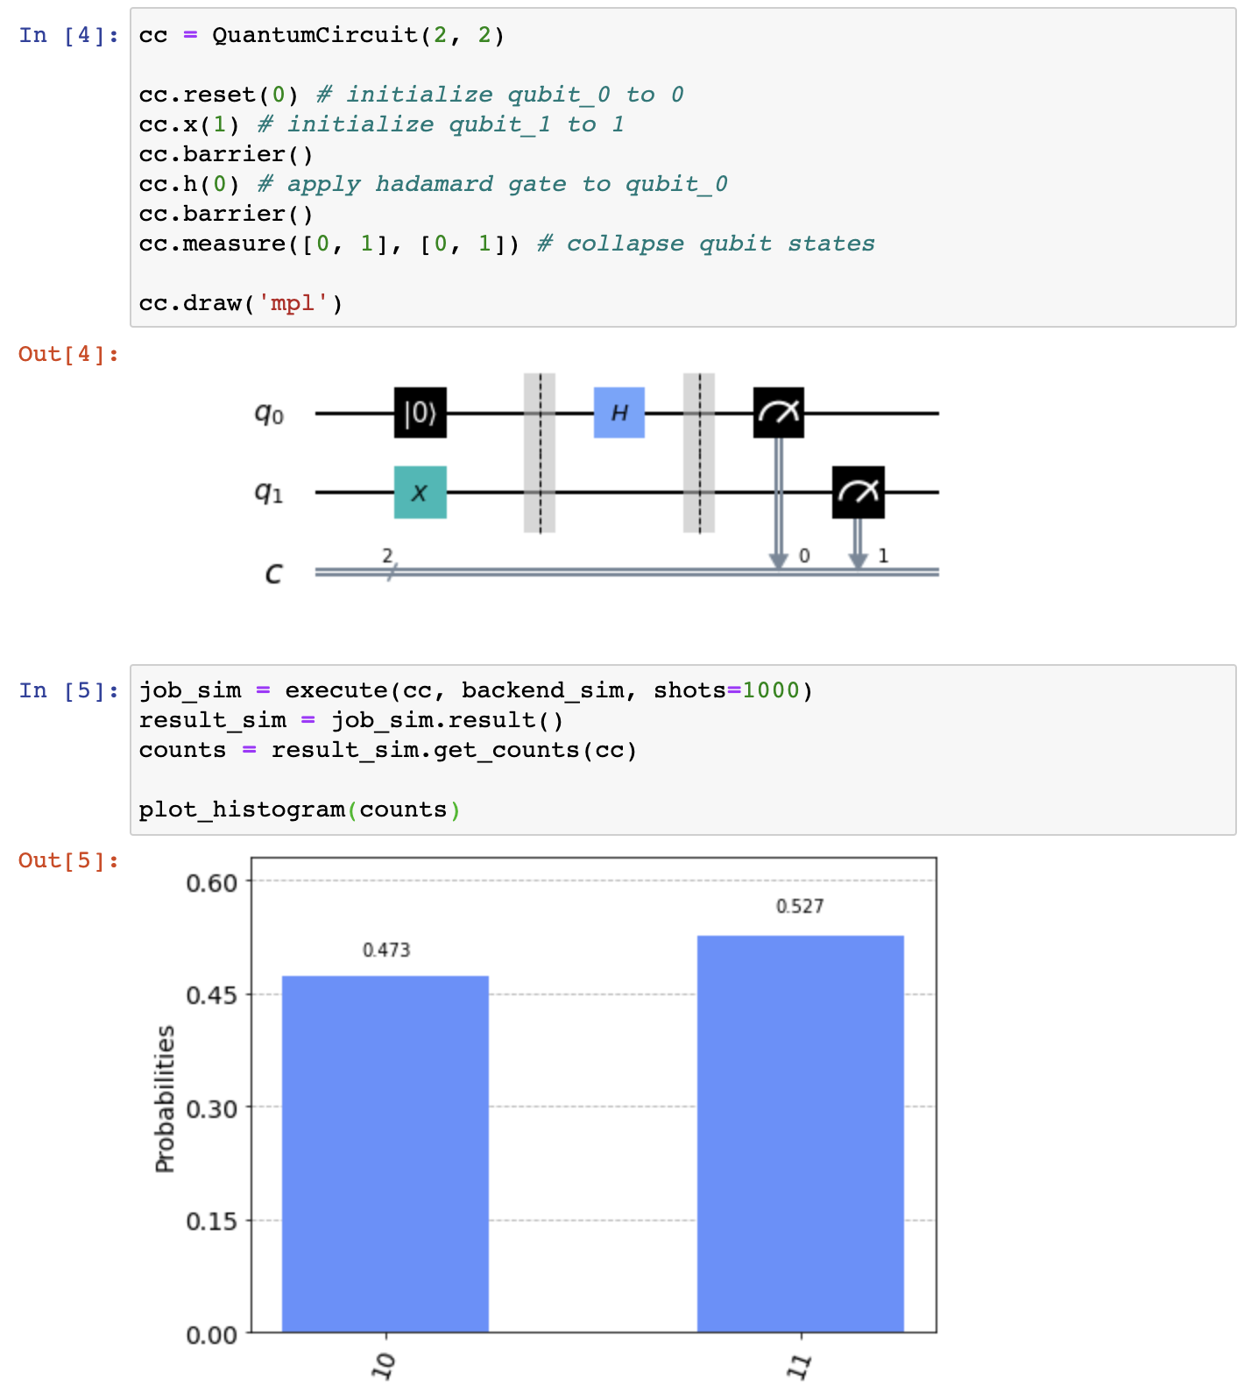
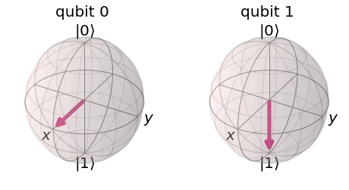
Qubit behaviors
Working with
Here, we can see a fundamental ability of qubits: superposition.
Notes:
Superposition refers to a combination of states we would ordinarily describe independently. To make a classical analogy, if you play two musical notes at once, what you will hear is a superposition of the two notes.

Slide 12
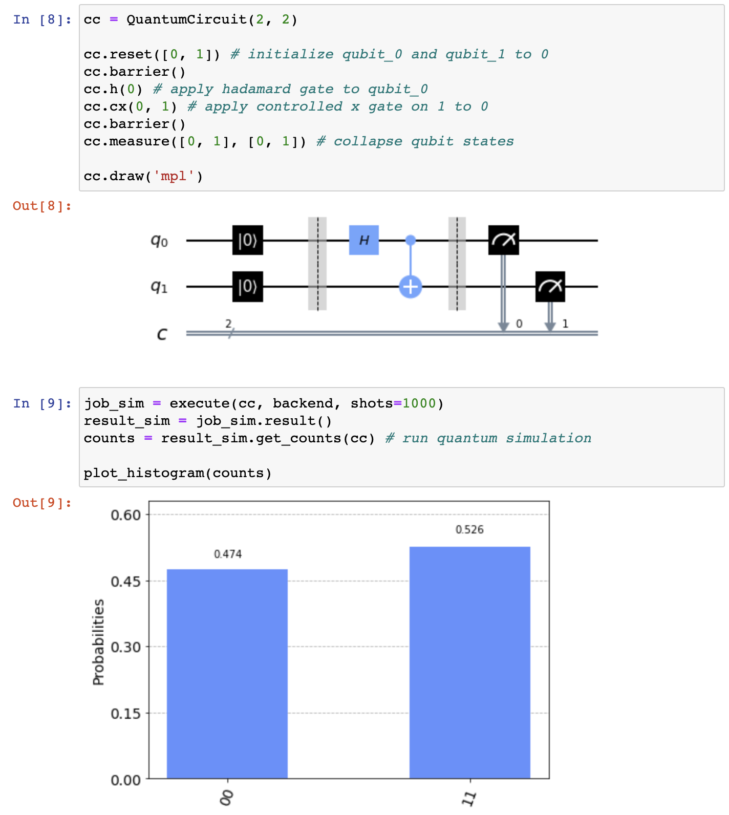
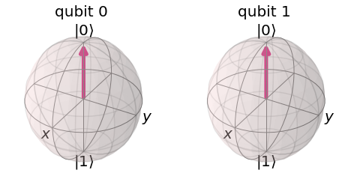
Qubit behaviors
Working with
Here, we can see a fundamental ability of qubits: entanglement.
Notes:
Entanglement is a famously counter-intuitive quantum phenomenon describing behavior we never see in the classical world. Entangled particles behave together as a system in ways that cannot be explained using classical logic.

Slide 13
Run on real quantum computers
Working with

Slide 14
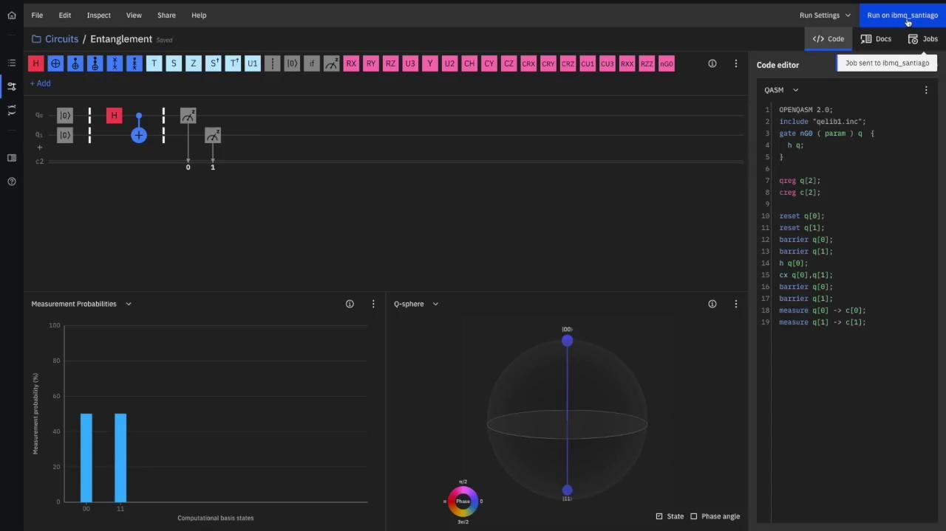
Real Entanglement
Working with

Slide 15
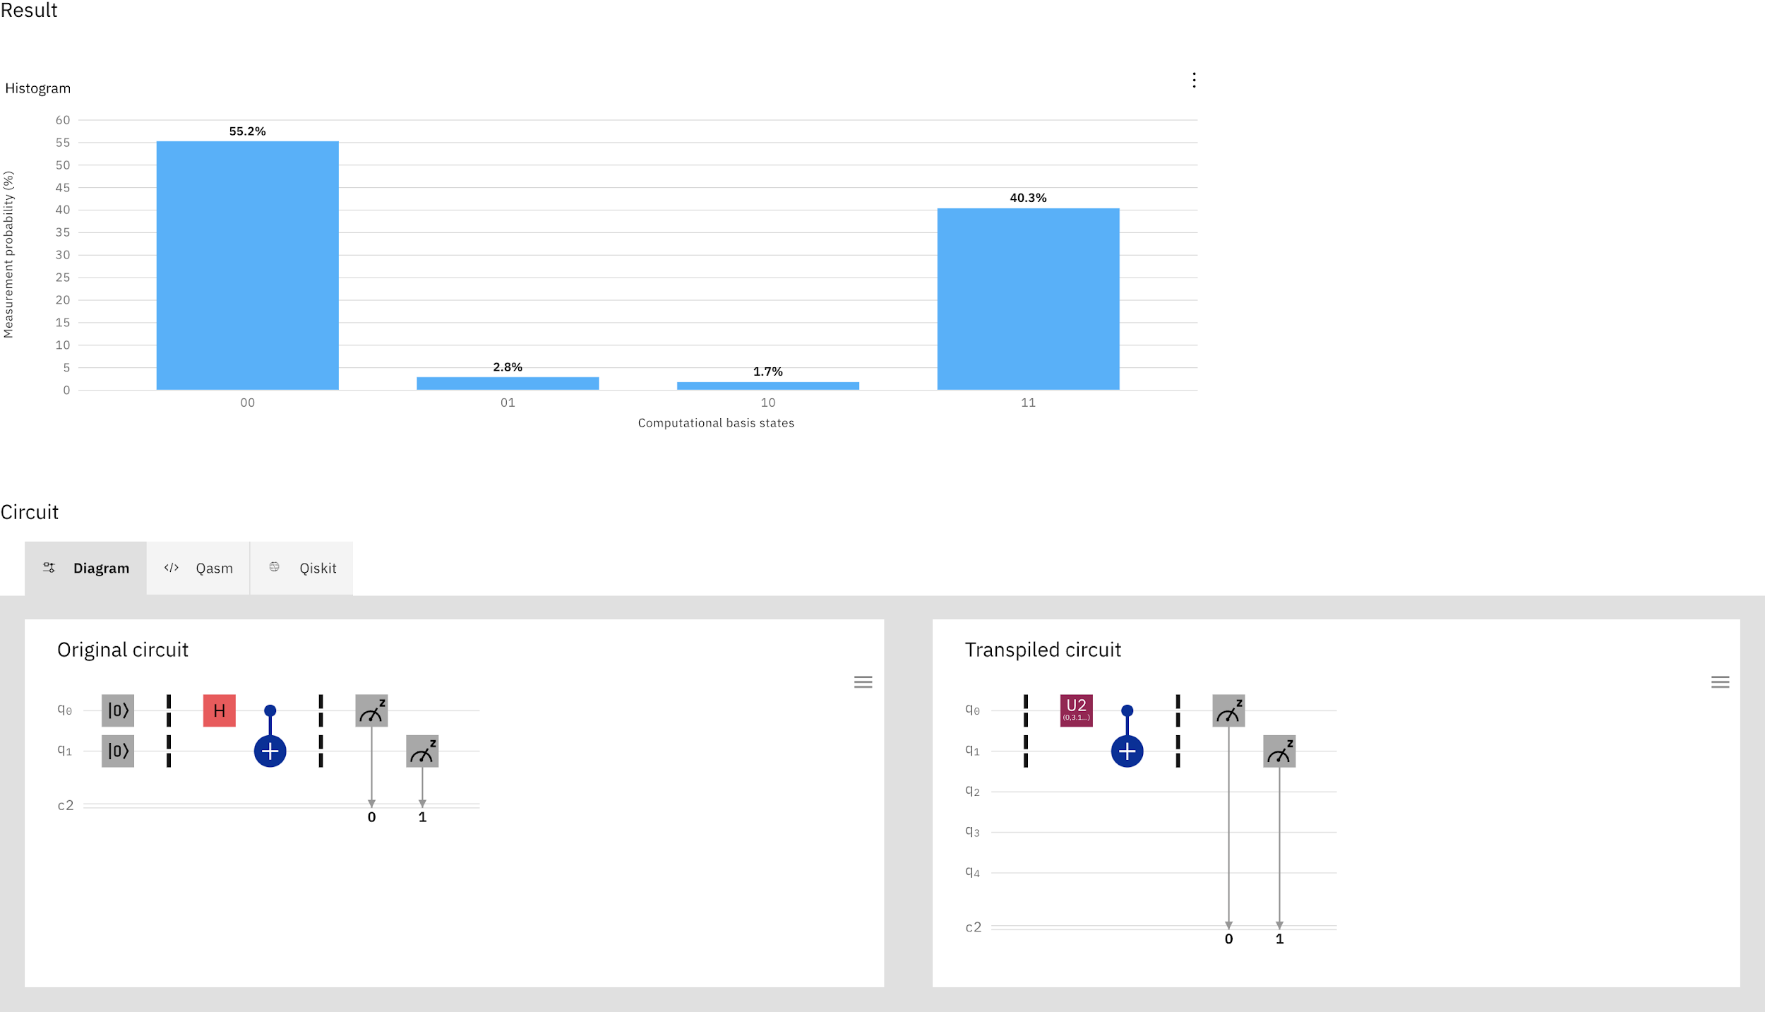
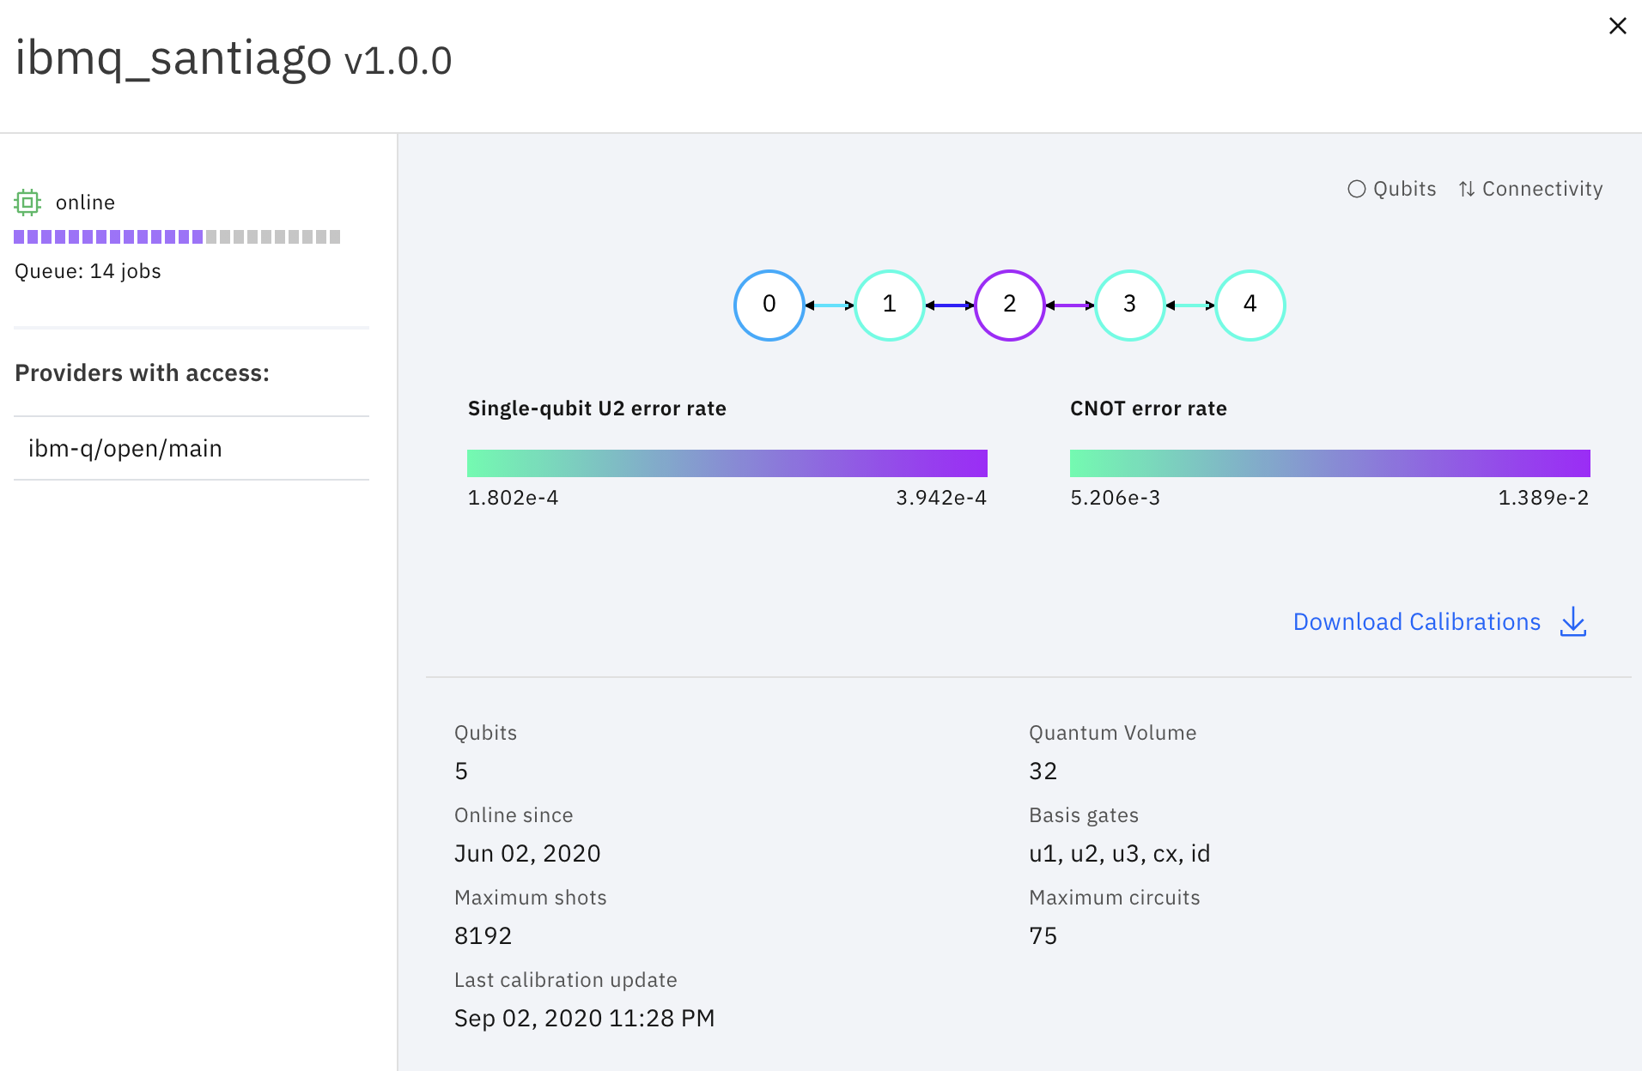
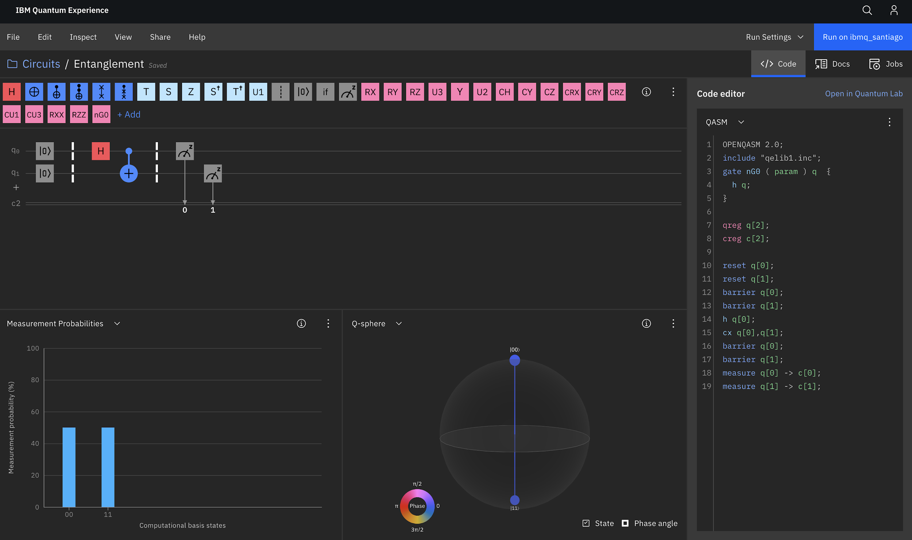
Result Analysis
Working with
Notes:
Decoherence: 1 → 0
Comfy state

Slide 16
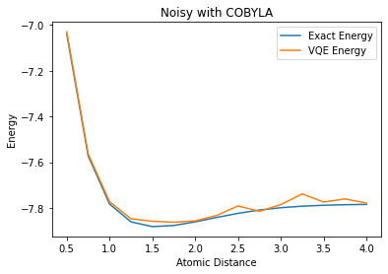
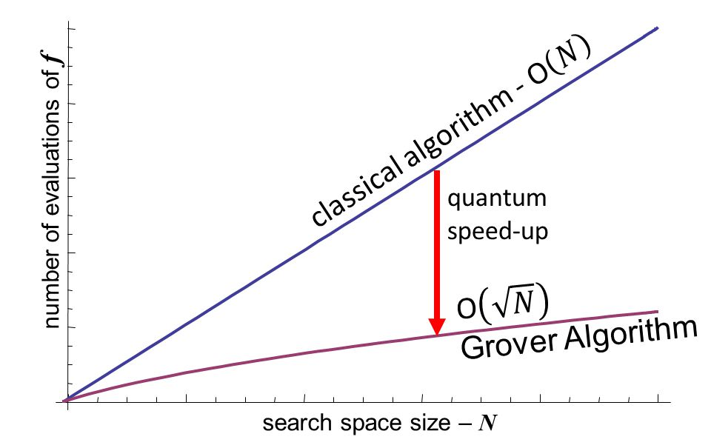
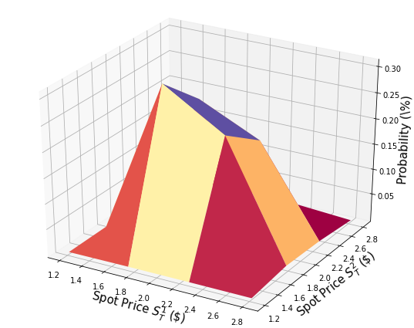
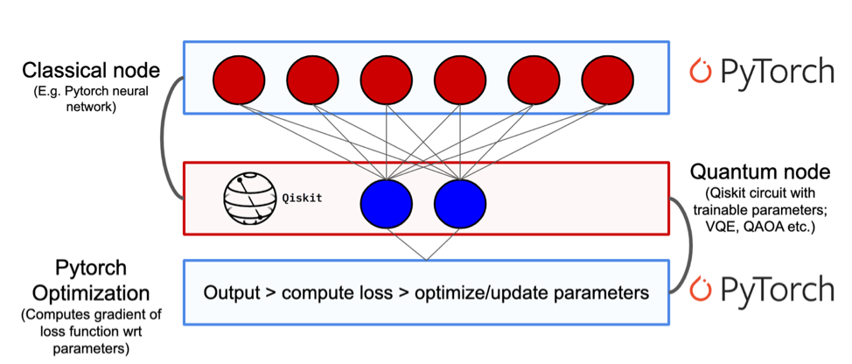
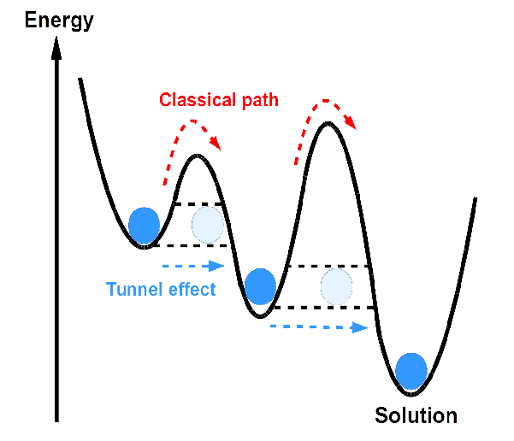
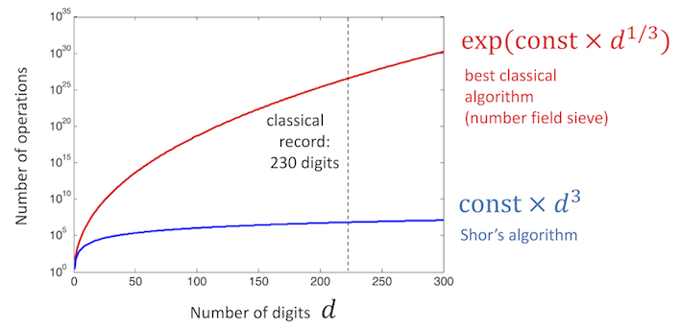
The Future of Quantum
Working in
Chemistry: molecule simulation
Search: random arrays
Finance: portfolio optimization
Machine Learning: q-nodes
Why you should be excited and get involved
Optimization: quantum tunneling
Encryption: period finding

Slide 17

Takeaways
Working in
We need quantum if we want more power
Qubits exhibit unique properties which can be leveraged
Simulate basic examples
Run circuits on hardware with Qiskit
The future of quantum brings big change
Not real... but pretty oo aa

Slide 18
How to get involved — Qiskit Plug
Working in
Learn: https://qiskit.org/learn/
Join: https://ibm.co/joinqiskitslack
Become: https://qiskit.org/advocates/
Research: https://www.ibm.com/quantum-computing/network/researchers

Slide 19
Sources
https://ibm.co/3lIitjx
https://github.com/splch/quantum-for-cs/blob/master/presentation%20code.ipynb
https://qiskit.org/learn/intro-qc-qh
https://www.ibm.com/blogs/research/2017/09/qc-how-it-works/
https://www.ibm.com/quantum-computing/learn/what-is-quantum-computing/
https://newscenter.lbl.gov/2016/10/06/smallest-transistor-1-nm-gate/
https://qiskit.org/documentation/tutorials/finance/06_basket_option_pricing.html
https://quantum-computing.ibm.com/docs/iqx/guide/shors-algorithm
https://slideplayer.com/slide/3169508/
https://medium.com/qiskit/project-highlight-hybrid-quantum-classical-machine-learning-e5319982e3b1
https://medium.com/@quantum_wa/quantum-annealing-cdb129e96601
Thank you! Questions?

